Slide 1
Library Management System
Team 25

Slide 2
Introduction
Aim – To provide a quality library service for everyone.
System and its interfaces are developed using C# language.
Database is produced using Microsoft SQL Server which is high in data integrity and data validation.
Triggers, Mechanisms related to data validation and user defined functions are used.
Views and stored procedures for retrieving operational data.

Slide 3
Objectives
Replacement of manual library management system.
Developing as system that is efficient and reliable than a manual system.
Making a user-friendly environment with attractive user interfaces.
Development of a database with a proper storage of information about the details of books, borrowers, authors, libraries and etc.

Slide 4
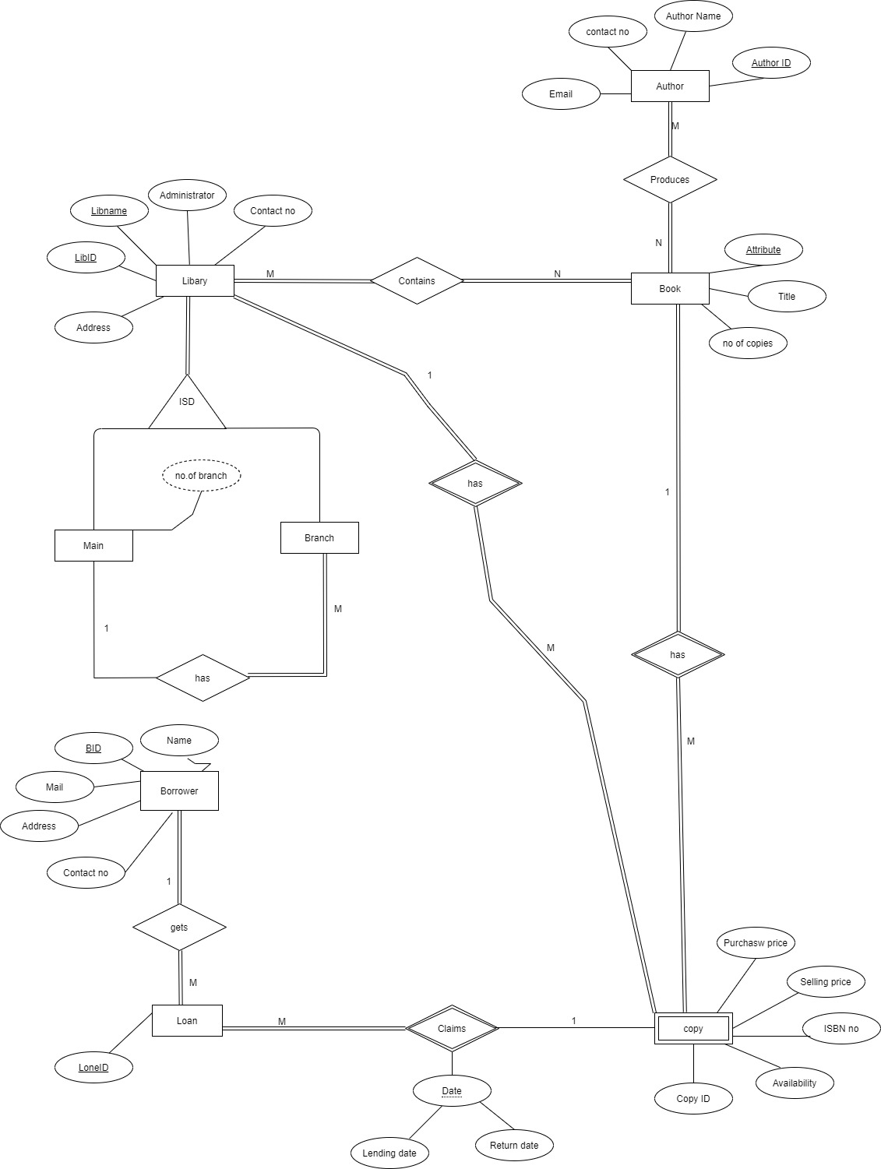
EER

Slide 5
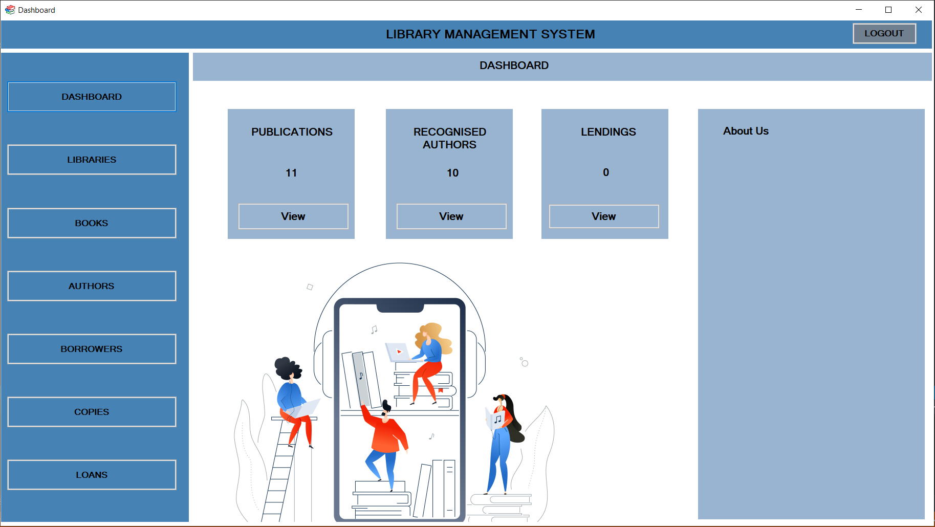
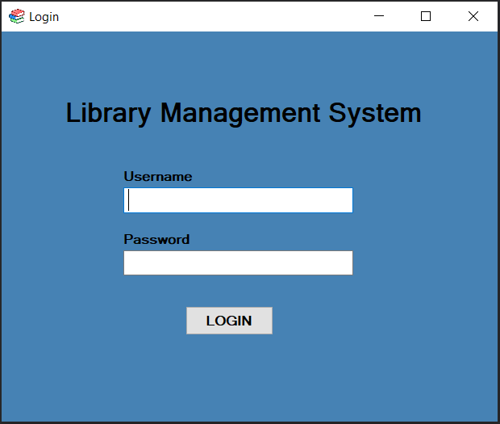
Library Management System (User Interfaces)

Slide 6
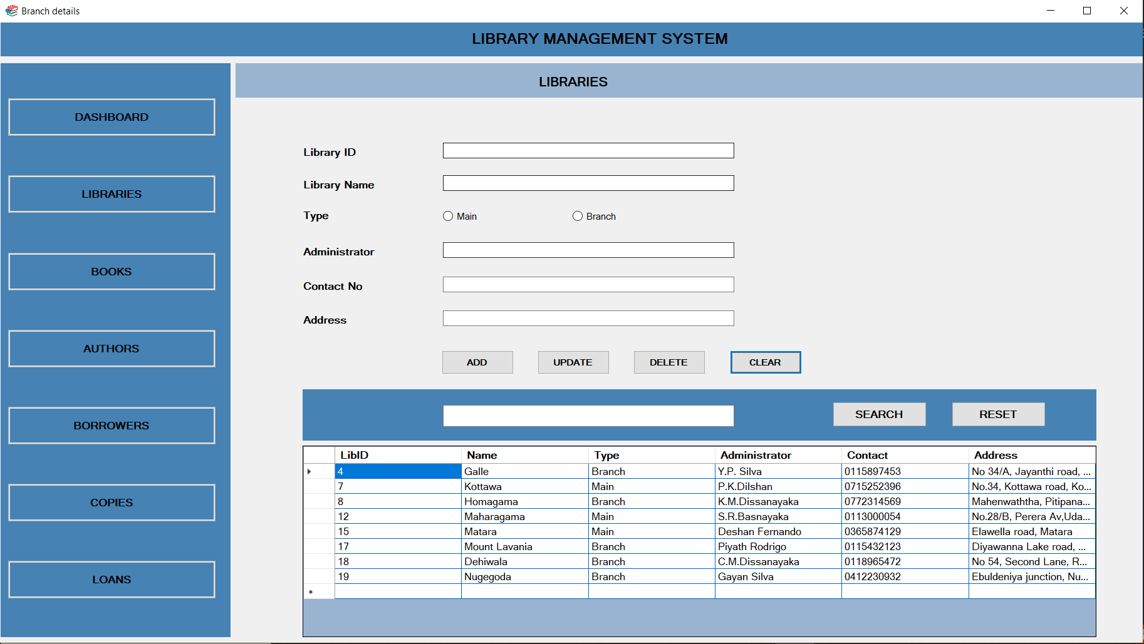
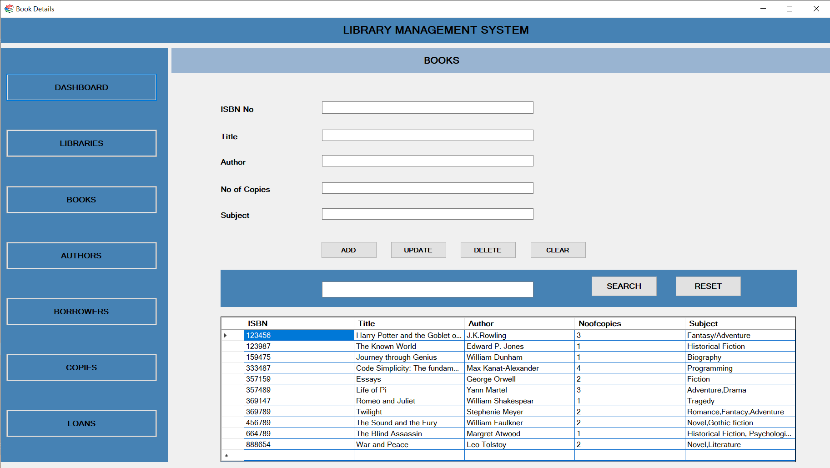
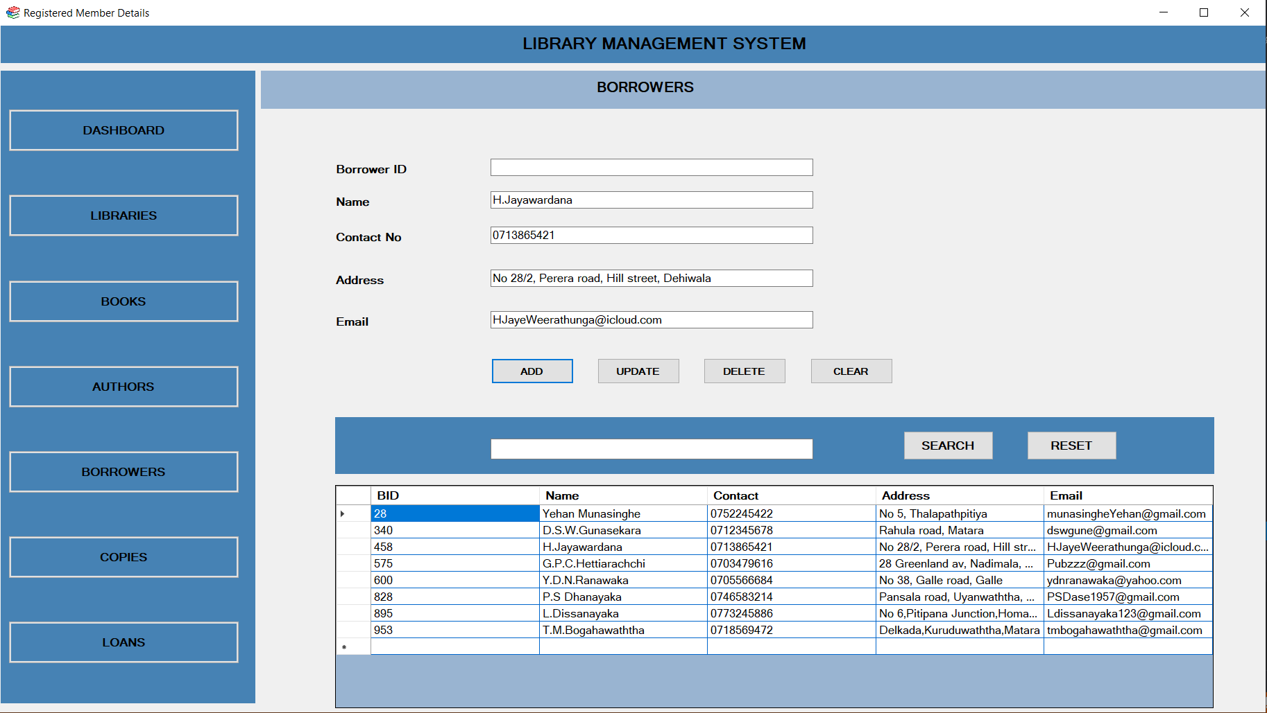
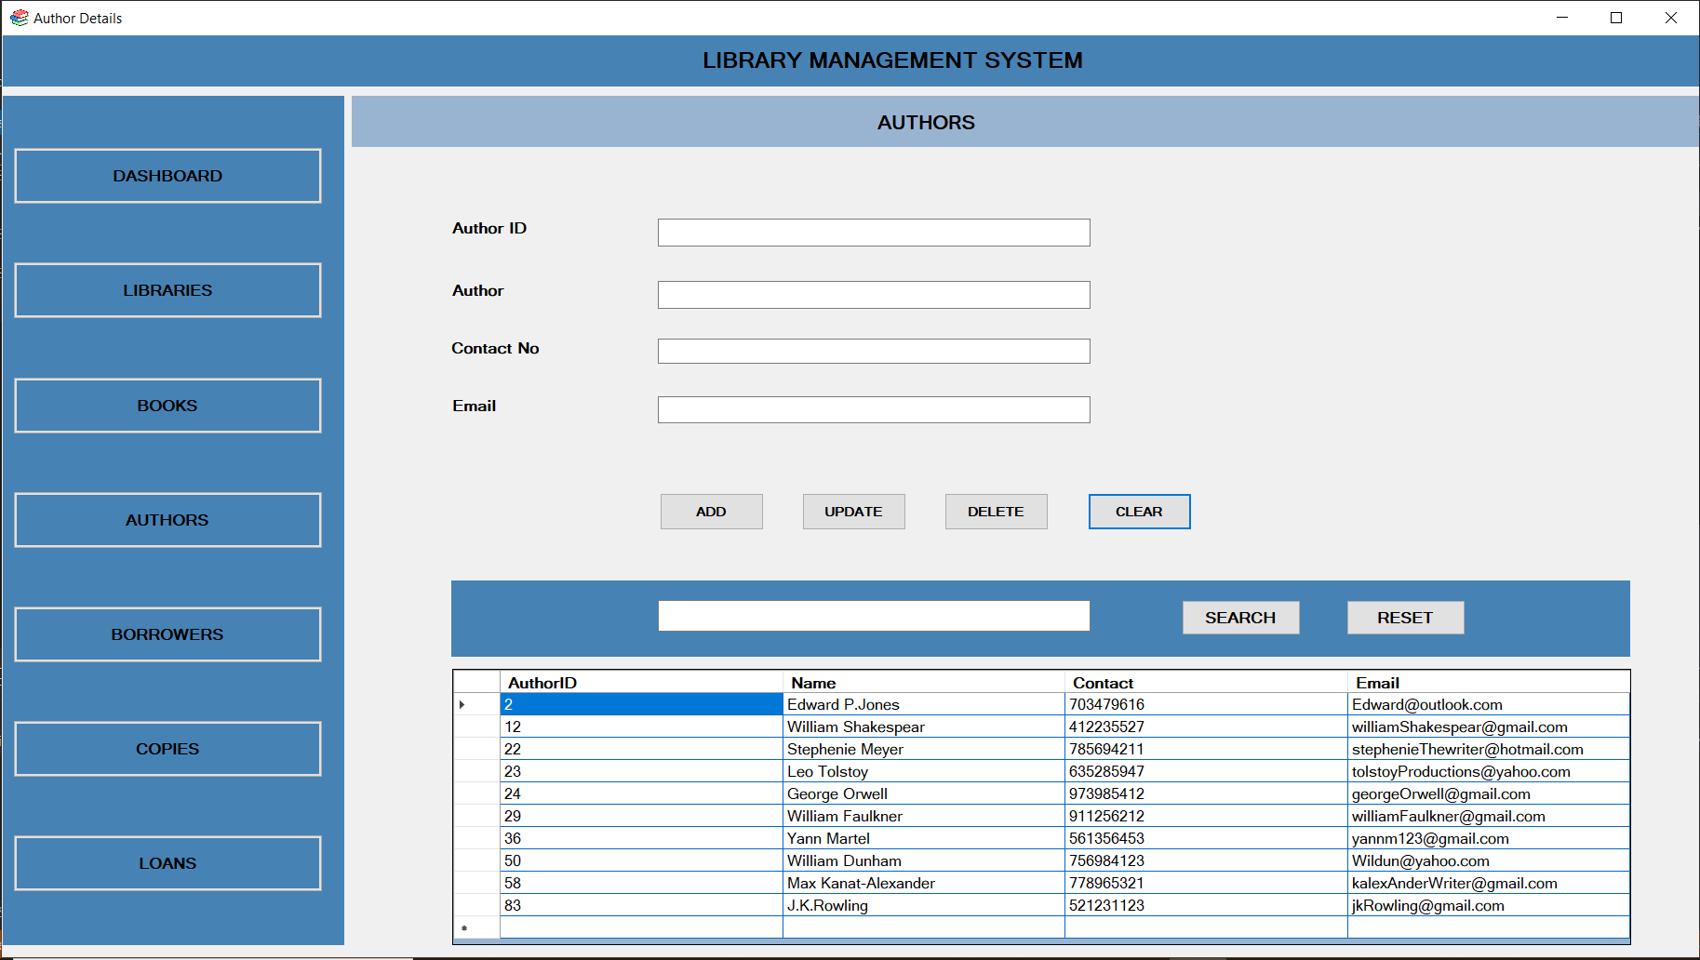

Slide 7
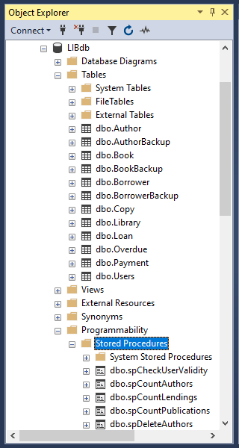
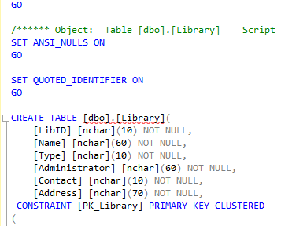
SQL SERVER MANAGEMENT STUDIO
CREATE TABLE STATEMENT

Slide 8
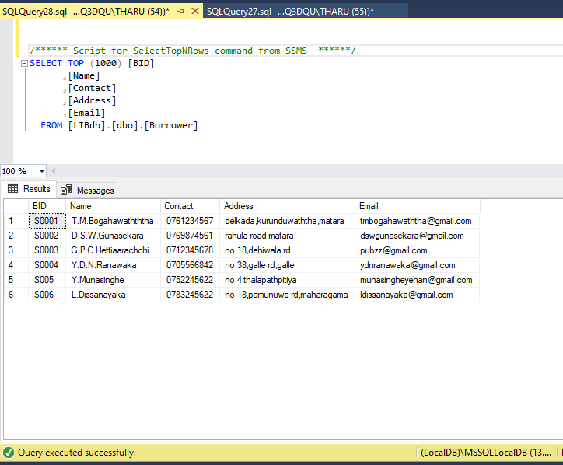
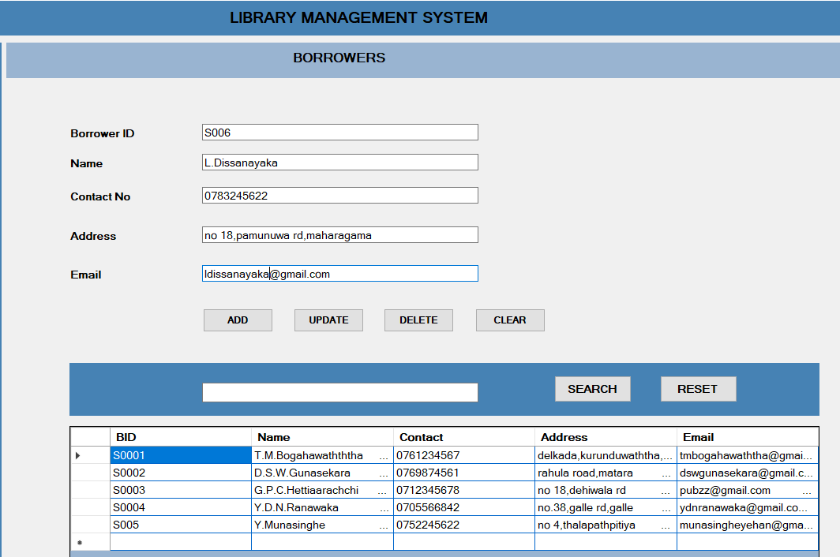
Example
MySQL server
System UI

Slide 9
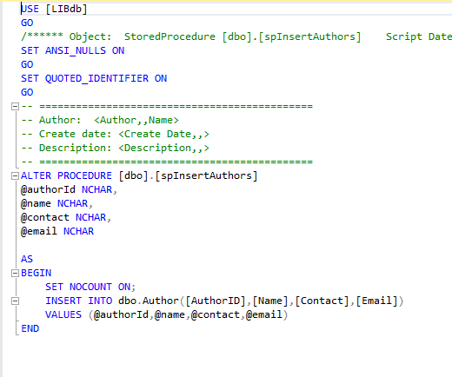
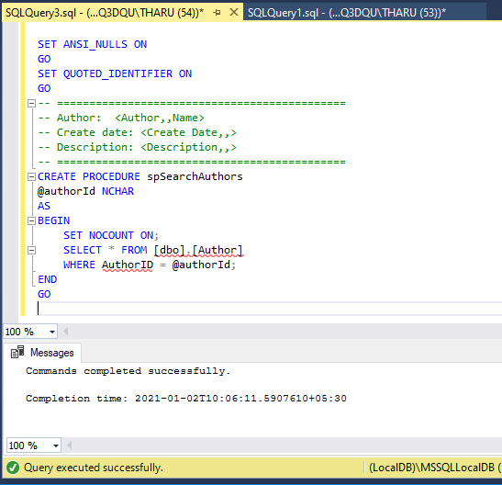
STORED PROCEDURES
This is a prepared SQL code that can be saved, giving the user the ability of using a code over and over again.

Slide 10
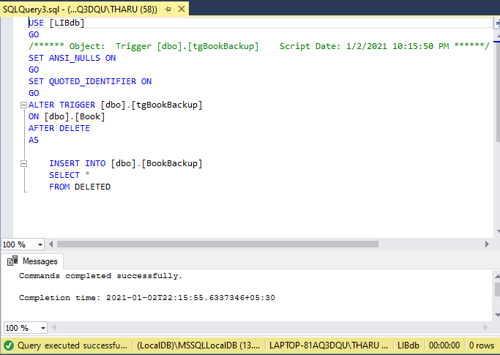
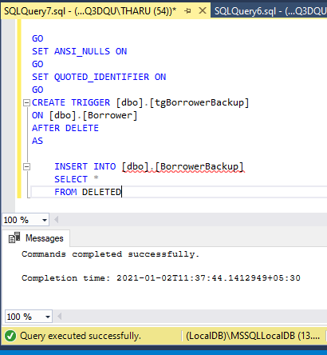
TRIGGERS
It is a special type of stored procedure which has the ability of running automatically when a certain event takes place in a database server . Triggers start running when users modify the data using DML.

Slide 11
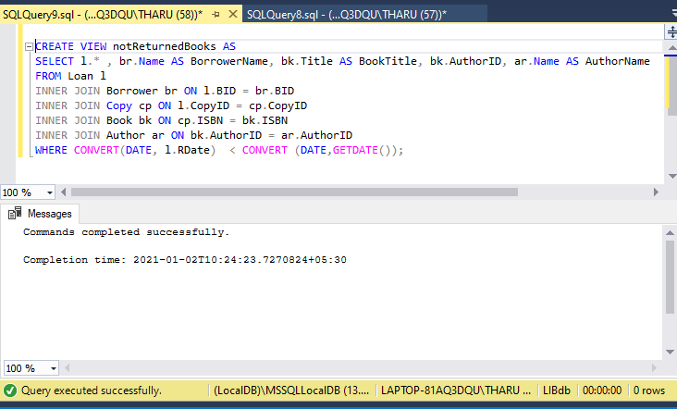
VIEWS
This represents a virtual table that is mainly based on the results of a certain SQL statements. This contains both rows and columns same as the ordinary tables

Slide 12
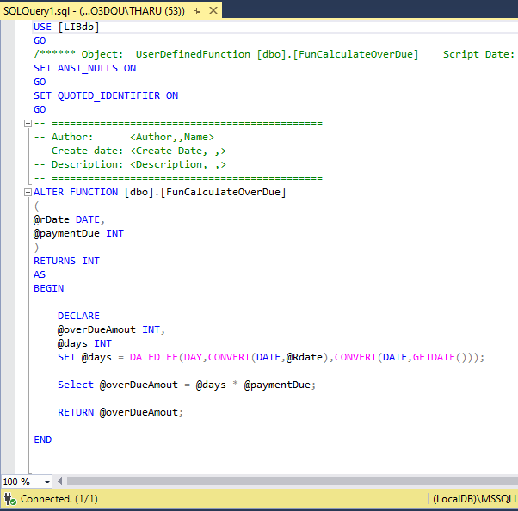
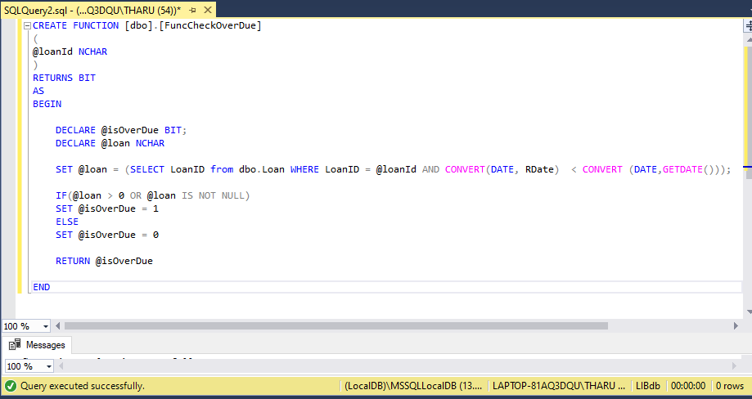
Functions
SQL server is consisted with several built in functions that are used in the performance of variety of tasks.

Slide 13
Future implementations
This is developed in a way that can accept further modifications.
The system will be further developed with more attractive interfaces.
The system will be further developed with Triggers for different other fields except the existing fields namely book, author, borrower.
Implementing the system to the public library in hometown and modify it further with the requirements of the staff.

